Slide 1



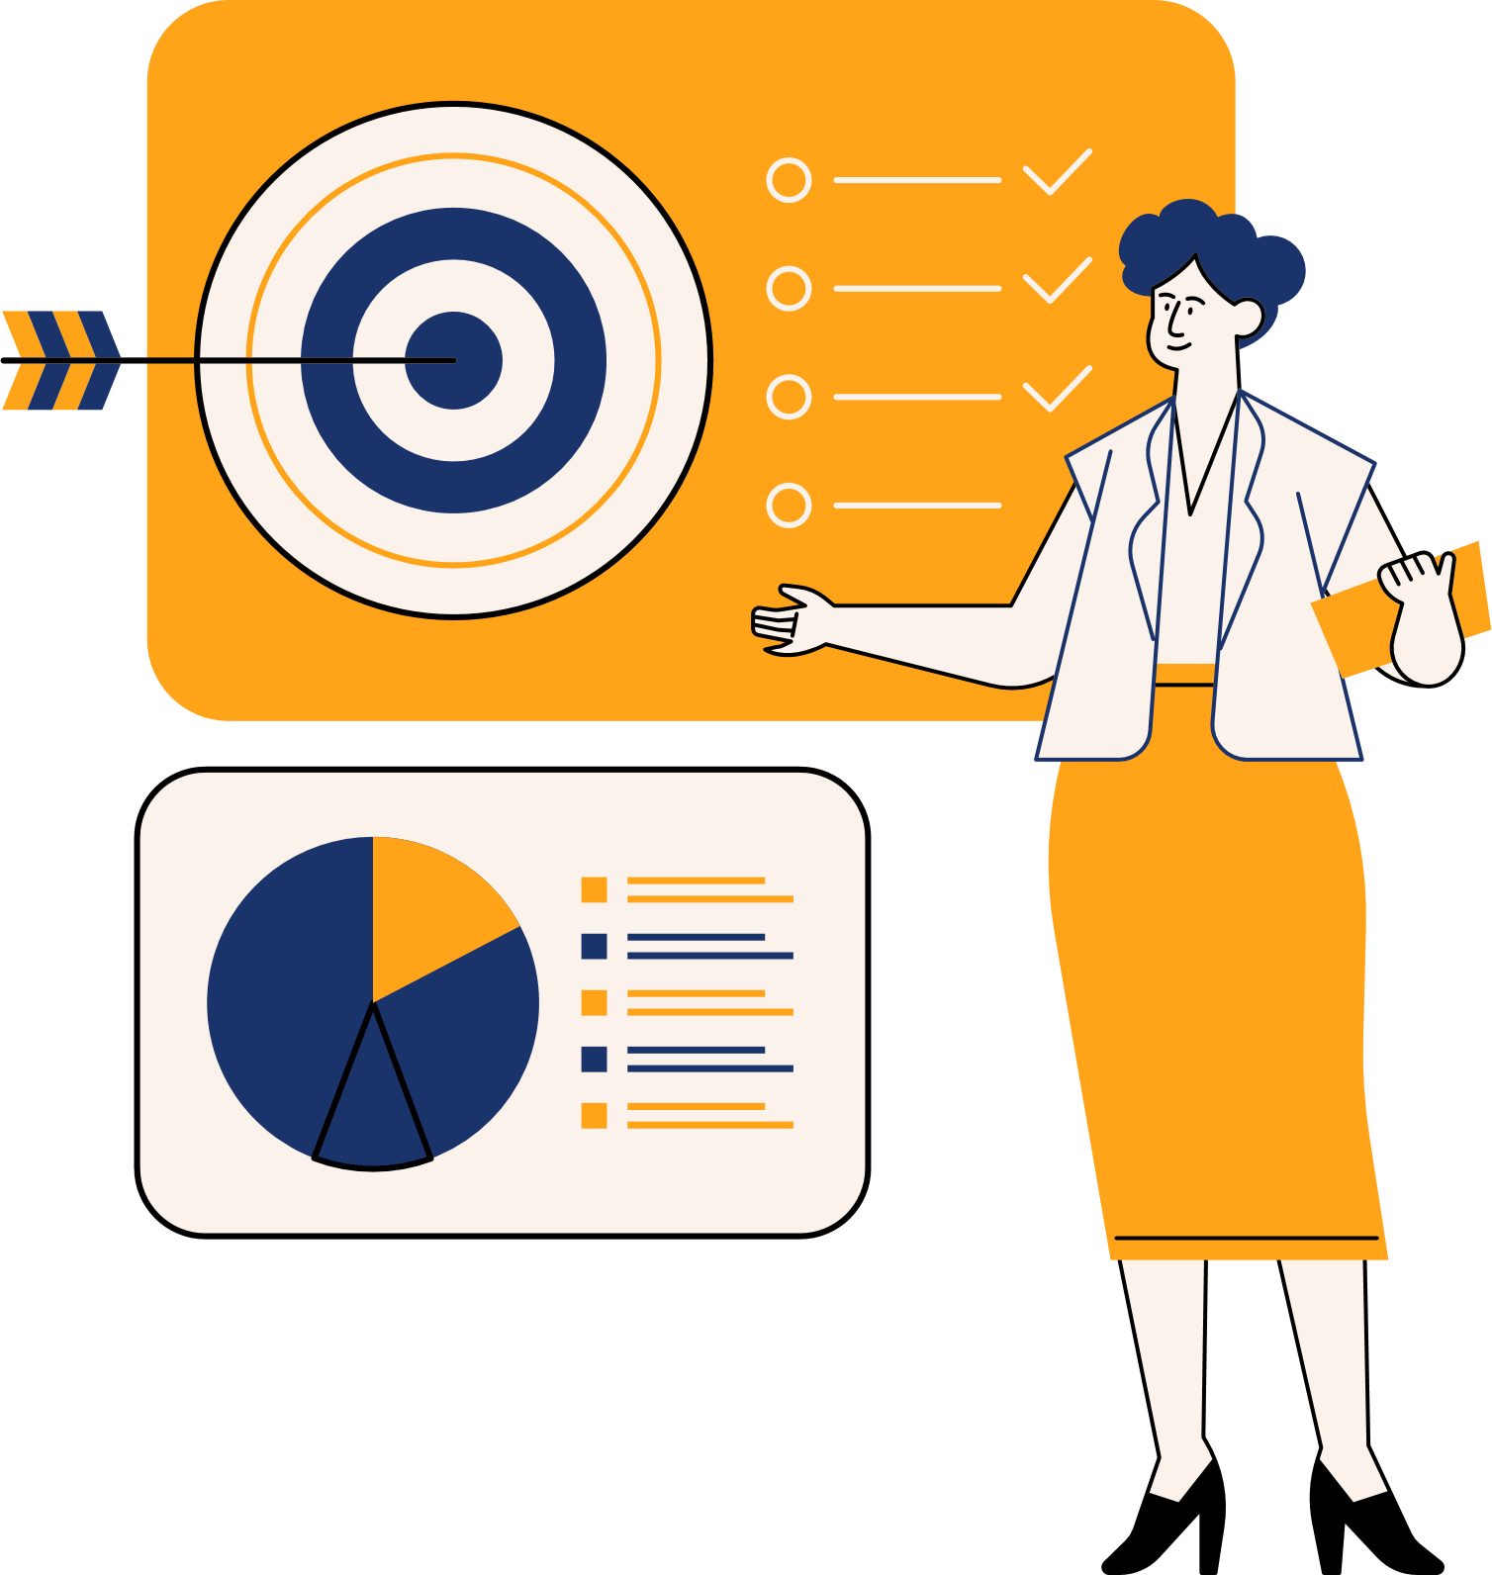

DIGTAL
MARKETING
STRATEGY
3

Slide 2




Presented by
Mohamed saafan
Yousef Ahmed
Shady Mohamed
Eslam Ahmed
Mohamed Ashraf

Slide 3



CONTENT
Introduction
Objectives SMART
SWOT analysis
Value Proposition
Marketing Mix
Segmentation
Competitive
Analysis
Accounts Analysis

Slide 4


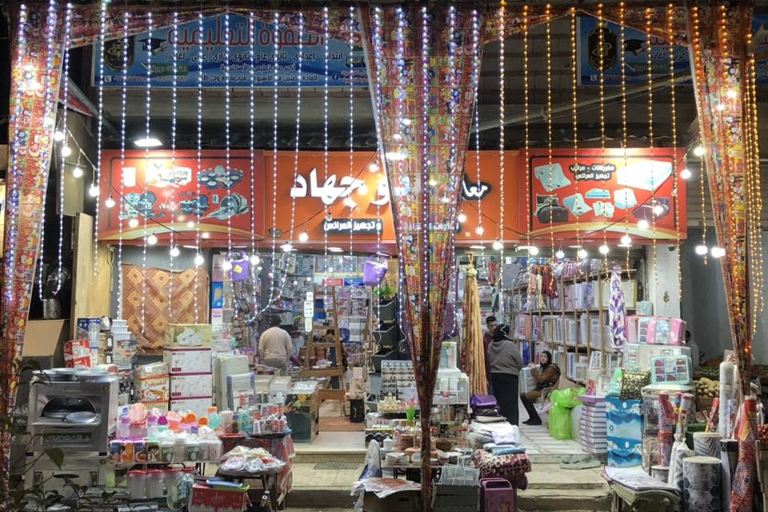




Introduction

Slide 5
Introduction
The Egyptian market is rich with numerous distinguished local brands that possess high-quality products and on-the-ground customer loyalty. However, they face a fundamental challenge represented by their weak digital presence in a highly competitive landscape.
The core problem lies in the gap between the true value these companies offer and their ability to reach broad segments of the audience that use digital platforms as a primary means for making purchasing decisions. This gap not only limits their growth opportunities but also threatens their long-term continuity.
And here, the value I provide as a digital marketing specialist becomes evident.
My mission is to act as a strategic partner for these companies to bridge this gap by building integrated digital marketing strategies. We transform their traditional assets and value into an influential force in the digital world, capable of attracting new customers, building brand loyalty, and achieving sustainable sales growth.
In this presentation, I will walk you through a practical case study that illustrates this methodology in detail, which is the project of developing the digital presence for "Abu Jihad Showrooms." We will see how the right digital strategy can unleash vast growth potential.

Slide 6
Objectives SMART
General Goal: Increase sales and digital presence for Abu Jihad's store within 6 months.
(SMART) Detailed Objectives:
1. Specific
Create a Facebook and Instagram page for the store and publish daily content (offers, products, bridal preparation tips).
2. Measurable
Reach 1,000 followers on Facebook within the first 3 months.
Achieve a 20% increase in sales through digital campaigns.
3. Achievable
Run paid ad campaigns with a monthly budget of 400 EGP on Facebook and Instagram to attract new brides.
4. Relevant
Link the content to special offers for bridal preparation, as this is the primary product that distinguishes the store.
5. Time-bound
Within 3 months: Reach 1000 followers and achieve a 30% increase in sales.

Slide 7



Strength
2025
A good reputation in the area and a well-known name (Abu Jihad).
Diverse products (household items + bridal trousseau/furnishings).
Competitive prices compared to large stores.
Strong relationships with local suppliers.
Long experience in the market.
SWOT analysis
Weaknesses
Limited reach (only one branch or local presence).
More traditional marketing than digital marketing.
Opportunities
Increasing demand for online shopping.
The possibility of collaborating with bloggers/influencers in the field of bridal preparation.
Opening new branches or selling through platforms like Jumia/Amazon.
Launching special offers and packages for bridal preparation.
Threats
Cheap imported products that are flooding the market.
Price volatility due to inflation and changes in the dollar exchange rate.

Slide 8


Value Proposition
Abo Gehad Store offers customers affordable, high-quality household and lifestyle products with a trusted shopping experience. The store combines variety, convenience, and personalized service, ensuring that customers always find what they need at the right price.

Slide 9

Marketing Mix

Slide 10
Marketing Mix
Product
Abo Gehad Store offers customers affordable, high-quality household and lifestyle products with a trusted shopping experience. The store combines variety, convenience, and personalized service, ensuring that customers always find what they need at the right price.

Slide 11
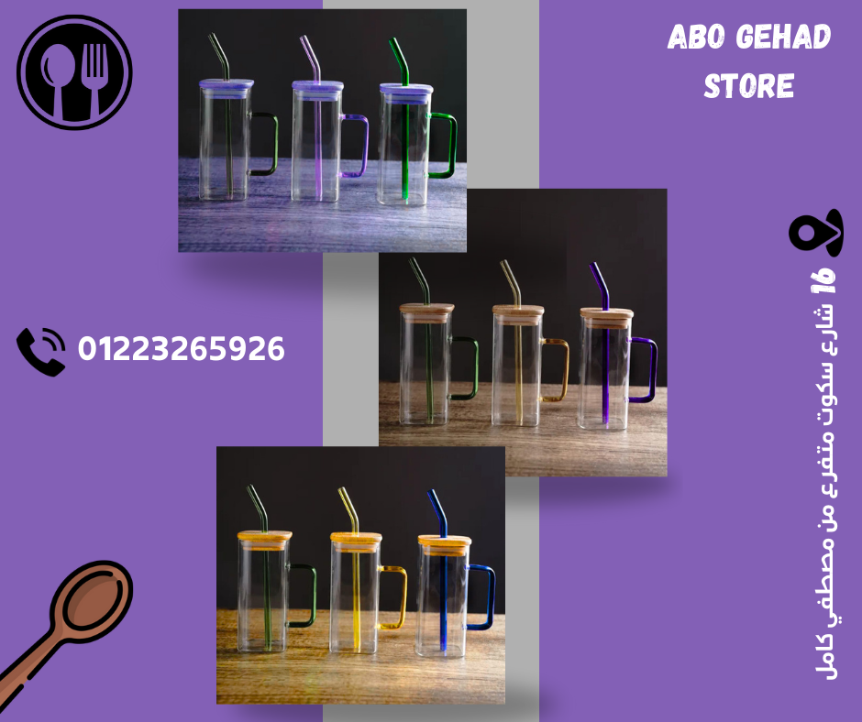

Marketing Mix

Slide 12
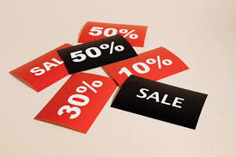
Marketing Mix
Price
Competitive pricing strategy.
Value-for-money offers.
Seasonal discounts and promotions.

Slide 13
Marketing Mix
Place
Offline locations
شارع 16 اسكوت -متفرع من مصطفي كامل

Slide 14
Marketing Mix
Place
Online channels
WhadtsAPP: 01223265926
Facebook: معارض أبو جهاد

Slide 15
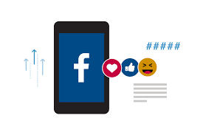
Marketing Mix
Promotion
Social Media Marketing: Post engaging content consistently with trending hashtags.

Slide 16
Segmentation
Demographic SegmentationAge: 25–55 yearsGender: Both male & femaleMarital Status: Newly married couples, familiesIncome Level: Middle to upper middle classGeographic SegmentationFocused on Egypt (especially urban areas and new cities)Psychographic SegmentationPeople who value comfort, style, and quality in their homesInterested in modern lifestyle and trendy home designsBehavioral SegmentationCustomers looking for seasonal offers and discountsFrequent online shoppers who search on Facebook, Instagram, and TikTokLoyal customers who return for new collections and updates

Slide 17
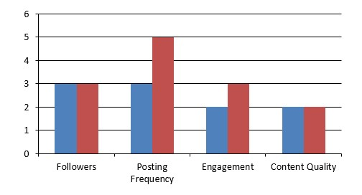
Competitive Analysis

Slide 18
Buyer Personas
Persona | Age | Status | Occupation | Goals | Challenges | Interests | Buying Behavior
Mona – The Bride-to-Be | 23-34 | Engaged | Fresh Graduate | Furnish new home stylishly Find bridal packages | Limited budget Confused about fabrics & designs | Trendy colors Bridal bundles | Relies on family/friends Checks social media
Om Ahmed – The Practical Housewife | 35-48 | Married, 3 kids | Housewife | Renew textiles with durable items Affordable quality | Balance price & durability Kids consume textiles fast | Easy-to-wash fabrics Discounts & offers | Trusted stores Shops with family
Mrs. Naglaa – Mother of the Bride | 48 | Married, mother of a bride | School Teacher | Prepare full bridal dowry Ensure high quality | Wants best value Needs one-stop shop | Complete bridal packages Warranty & after-sale service | Trusts reputable stores Prefers consultation

Slide 19
Content Creation
في بيدج الفيس بوك
(5) معارض ابو جهاد -Abo Gehad Stores | Facebook

Slide 20
Business Model
Canvas

Slide 21
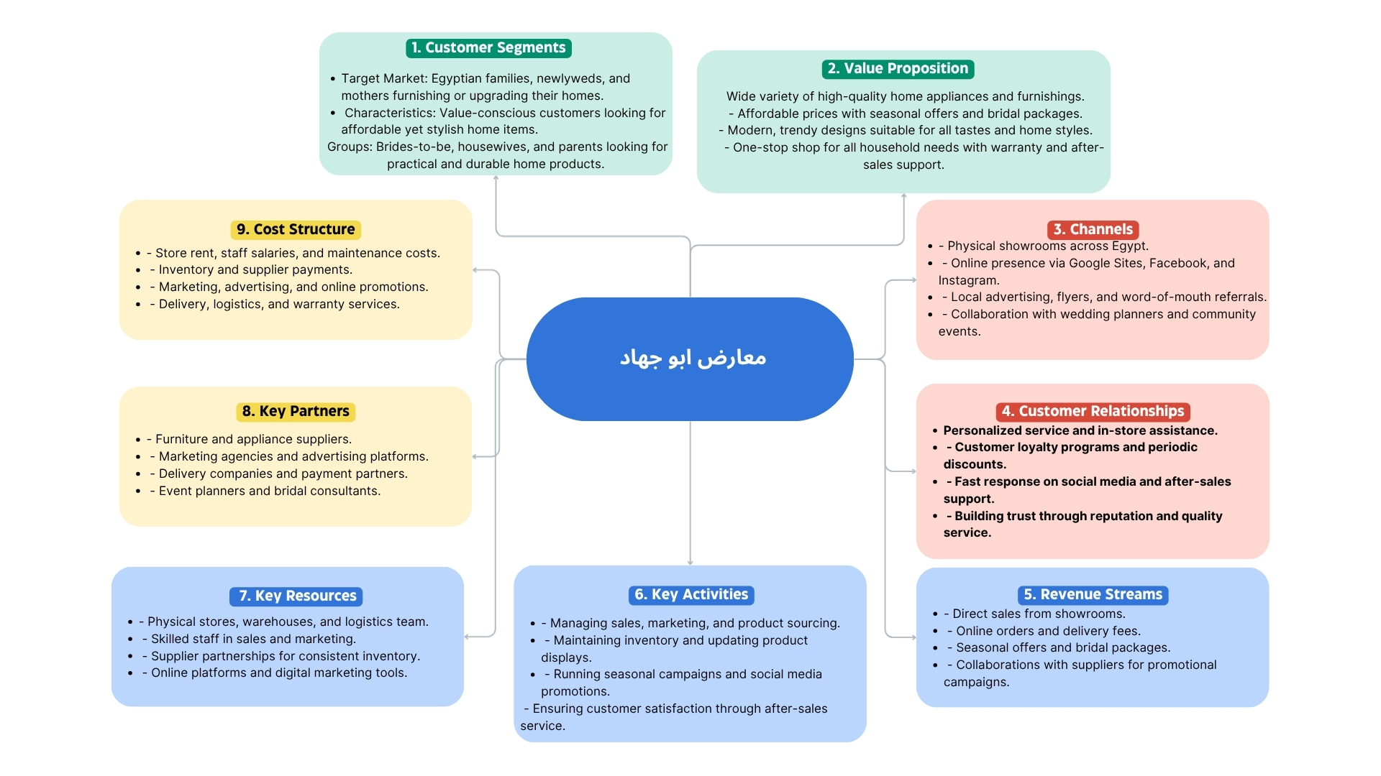

Slide 22
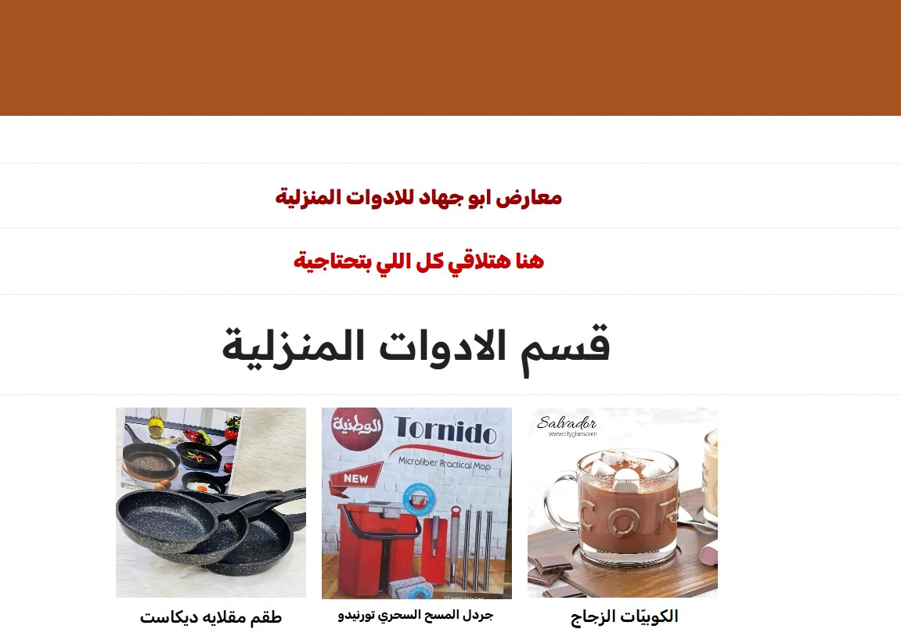
Website

Slide 23
Media Buying and Implementation Results
Campaign Overview
Objective: Increase page visits, engagement, and inbound messages for a restaurant.
Duration: 3 days
Daily Budget: EGP 80
Key Results
Clicks: 5,918
Page Visits: 416
Messages Received: 159 qualified inquiries
Cost per Visit: EGP 0.58
Followers Growth: Increased from 900 → 1,037 during the campaign
Impact
Increased brand visibility and customer engagement
Delivered high-quality leads with a low cost
Achieved noticeable growth in page audience and interactions within a short timeframe

Slide 24
Media Buying and Implementation Results

Slide 25
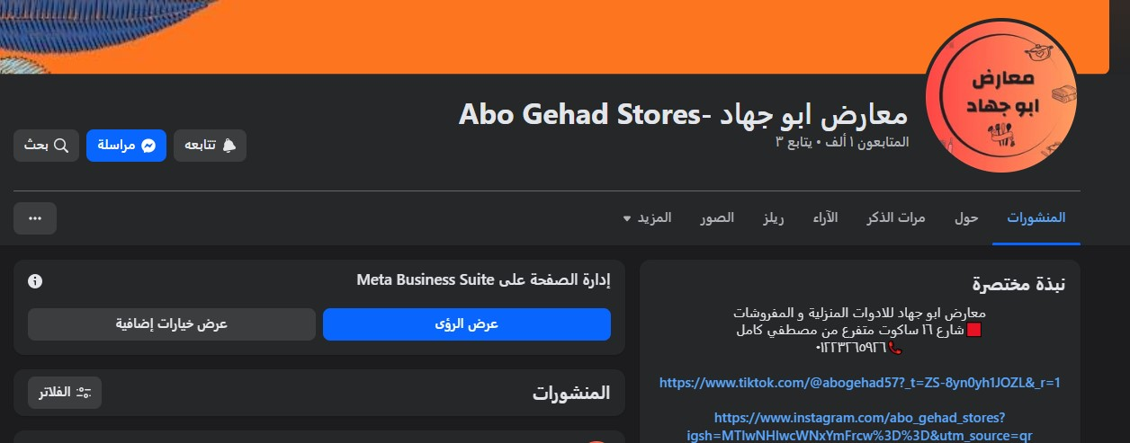
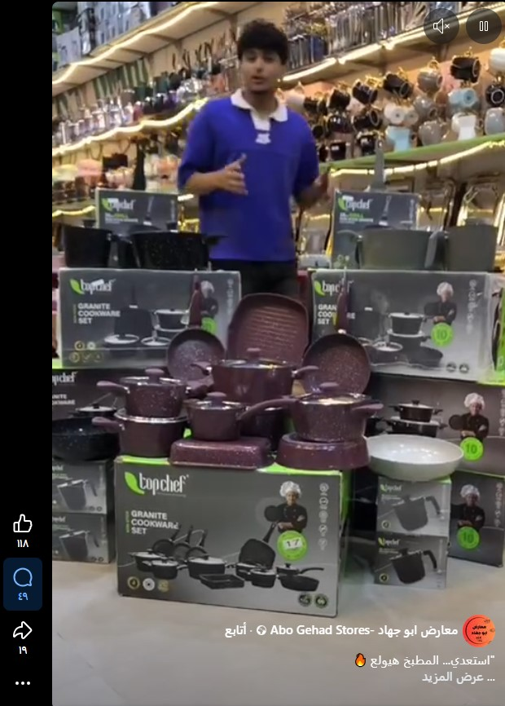
Media Buying and Implementation Results

Slide 26
SEO PLAN

Slide 27
SEO PLAN
Increase the visibility of “Abu Jehad Stores” on Google search results when people look for home appliances, furnishings, offers or discounts, or new household products.

Slide 28
Boost Our Online Presence
We aim to :
Appear on Google when people search for home tools
Attract more customers without paid ads
Increase brand visibility locally and online

Slide 29
Keywords Strategy
We aim to :
Target terms like “kitchen tools,” “home gadgets”
Use keywords in titles, product descriptions, and meta tags
Focus on specific long-tail keywords to reach buyers effectively

Slide 30
Make Our Website User-Friendly
We developed our website with these Features :
Fast loading speed
Mobile-friendly design
Simple navigation & organized categories

Slide 31
Keywords Strategy
We aim to :
Target terms like “kitchen tools,” “home gadgets”
Use keywords in titles, product descriptions, and meta tags
Focus on specific long-tail keywords to reach buyers effectively

Slide 32
Suggested Topics
Category | Suggested Topics
Offers & Discounts Section | - Latest Abu Jehad Home Appliances Offers - End-of-Season Discounts on Furnishings - How to Get the Most Out of Store Offers
Bridal Preparation Section | - Complete Bridal Home Essentials Checklist - Tips for Setting Up the Bride’s Kitchen on a Budget - Useful Gift Ideas for Newlyweds
Furnishings Section | - How to Choose the Right Bed Sheets for Your Room - Top Furnishing Trends for 2025 - Best Fabric Materials for Bedding and Curtains in Egyptian Homes
Home Appliances Section | - Top 10 Home Appliances Every Home Should Have - Modern Kitchen Tools That Make Your Daily Life Easier - Your Guide to Choosing the Perfect Kitchen Blender

Slide 33
Hard Start For a Nice End
Summary:
We optimized SEO that helps more customers find Abu Gihad Store
We Optimized content, keywords & website for better sales
We make a strong online presence for stronger brand visibility

Slide 34
Analysis Report
The “Abu Jehad Home Appliances & Furnishings” Facebook page was launched two months ago and organically gained over 900 followers without any paid advertising. To further boost reach and engagement, the team launched a sponsored Facebook campaign with a budget of 80 EGP per day for 4 days, aiming to increase brand awareness and attract potential customers.

Slide 35
Recommendations
# | Recommendation | Purpose
1 | Extend the Facebook campaign duration from 3 days to 7 days. | To reach a larger audience and achieve higher engagement.
2 | Use short video content (Reels) to showcase products. | Short videos attract more attention and boost interaction.
3 | Try “Messages Ads” on Facebook. | To communicate directly with potential customers interested in buying.
4 | Respond quickly to comments and messages. | Builds trust and encourages customers to make purchase decisions.
5 | Improve the website or create a Google Business profile. | To increase online visibility and brand credibility.
6 | Launch seasonal offers (e.g., Bridal Week Sale or Ramadan Discounts). | To attract customers during high-demand periods.

Slide 36

THANK YOU

